Slide 1



CORPS’ REAR AREA SECURITY (RAS)
Major Javier Donesteve. Spanish Army
Support Division, Allied Rapid Reaction Corps (ARRC)

Slide 2
SCOPE
NATO Force Structure (NFS)
The ARRC.
Corps’ Rear Area.
Rear Area Operations.
Rear Area Security.
Takeaways.

Slide 3
NATO Force Structure (Land)
NATO FORCE STRUCTURE:
NATO Force structure roles are dictated by the Long Term Commitments Plan (LTCP),and change on a rotational basis. Roles include:
Joint Task Force HQ
Multi-Corps Land Component Command (MC LCC)
NATO Response Force LCC
WF Corps HQ
ARRC
Innsworth, GBR
1 DEU/NLD CORPS
Münster, DEU
MNC - NE
Szczecin, POL
RRC-FRA
Lille, FRA
MNC - SE
Sibiu, ROM
EUROCORPS
Strasbourg, FRA
NRDC-ITA
Milan, ITA
NRDC-TUR
Istanbul, TUR
NRDC-ESP
Valencia, ESP
NDC-GRC
Thessaloniki, GRC
Notes:
In order to accomplish the full spectrum of Alliance missions, the NATO Command Structure is supported by the NATO Force Structure. The force structure provides three broad categories of forces:
In-Place Forces
Deployable Forces
Long Term Build Up Forces
In-Place Forces (primarily for Collective Defence) and Deployable Forces, both held at graduated readiness levels.
The third category known as Long Term Build Up Forces which provide forces generally associated with generation of capabilities for large scale Article 5 operations held at very low readiness.
SACEUR has nine Graduated Readiness Forces (Land) Headquarters under Operational Command. The role of each of these GRF(L) is dictated by the Long Term Commitments Plan, which will be covered in greater detail later on.
MNC(SE)??

Slide 4

HEADQUARTERS ALLIED RAPID REACTION CORPS (ARRC)
Notes:
ARRC demonstrates the UK’s commitment to NATO and the British Army's reference status through the Corps headquarters’ ability to operate across the spectrum of conflict from competition up to warfighting at scale against a peer enemy.
ARRC integrates the delivery of multi-domain effects in support of NATO's Defence and Deterrence of the Euro Atlantic Area (DDA) and NATO's Warfighting Capstone Concept (NWCC). The demonstrable capacity to fight with up to five divisions under command underpins credible deterrence in an era of multiple threats and persistent competition.
On 1 Jan 20, ARRC achieved Initial Operating Capability as NATO’s Corps Warfighting Headquarters at readiness - a first since the fall of the Berlin Wall. ARRC’s unique opportunity is to specialize as a Corps HQ and blaze a trail for both NATO and the UK.
Concurrently, ARRC's utility below the threshold of conflict will be enhanced through an ambitious programme of Mutual Training Support and deployments into Europe with sister High Readiness Forces and USAREUR. A separate operational focus for mutual capacity building prioritises Ukraine, Estonia and Romania in order to enhance influence, understanding and insight.

Slide 5
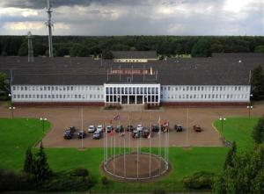
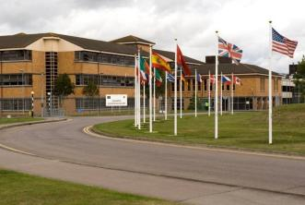
ARRC History
1992: Activated, Bielefeld, Germany
1994: Moved to Rheindahlen, Germany
2010: Moved to Innsworth, Gloucestershire, UK
RHEINDAHLEN
INNSWORTH
Notes:
5

Slide 6

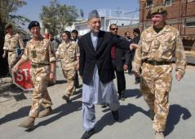
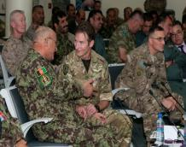
Operational Record
1995: Bosnia – Corps HQ (Peace Support)
1999: Kosovo – Land Component Comd HQ (Peace Support)
2006: Afghanistan – Theatre Joint Task Force HQ (Counter-Insurgency)
2011: Afghanistan – Corps HQ (Counter-Insurgency)
Notes:
6
6

Slide 7

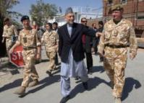
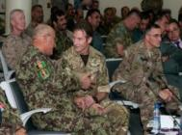
HQ ARRC Operational Record
1992 to 2002: Only NATO 3* HQ @R
1995: Bosnia - Corps HQ (Peace Support)
1999: Kosovo - Land Component Comd HQ (Peace Support)
2006: Afghanistan - Theatre Joint Task Force HQ (Counter-Insurgency)
2009: NRF (@R)
2011: Afghanistan - Corps HQ (Counter-Insurgency)
2013: NRF (@R)
2015/16: Joint Task Force HQ (@R)
2017: Land Component Command for the Enhanced NRF (@R)
2024: NRF (@R)
Notes:
7
7

Slide 8
ARRC Mission
Deliver NATO’s Corps Warfighting HQ at 20 days Notice to move in order to contribute to NATO’s deterrence of our adversaries and the defence of our allies in an era of persistent competition.
COMARRC’s Directive 2021
Notes:
8
This is the bespoke mission given to ARRC HQ by COM ARRC in his 2020 Directive. It recognises the requirement for the ARRC to be held at R4 and the primary purpose of facilitating NATO requirements.

Slide 9


Command and Control
CDS Directive
C2TA between UK SoS and SHAPE
ARRC MOU
Army Plan
CGS
SACEUR
CFAO
CFA
AD 80-98
LANDCOM
AD 80-96
Fd Army Plan
SAGE
LTCP
AOO
OPCOM
OPCOM
FULLCOMD
DIRLAUTH
Notes:
The ARRC is a NATO High Readiness Force (Land) HQ with the UK as Framework Nation. The ARRC HQ has a dual OPCOM relationship, reflecting the HQ’s nature as an entity maintained by the UK with the primary purpose of facilitating NATO requirements. As such the ARRC can deploy under a NATO, national or coalition mandate.
C2 during peacetime:
HQ ARRC is OPCOM SACEUR and SHAPE will direct HQ ARRC activity including participation in major exercises, and preparation for and deployment on operations. In addition DIRLAUTH is in place with HQ LANDCOM, which has the remit to coordinate activity across NATO Land HQs within the NATO Force Structure.
HQ ARRC is also OPCOM CGS (delegated to CFA), who is responsible for ensuring that HQ ARRC and the ARRC Gp is properly maintained, supported, enabled and held at readiness in order to meet NATO commitments.
C2 on operations:
HQ ARRC may be deployed on a NATO operation by SHAPE in a time of crisis, once a political decision has been made. In this case, it is expected that the ARRC Gp and those formations generated through the NATO Force generation process, would also become OPCOM SACEUR.
HQ ARRC may also be deployed on non-NATO operations, either UK national operations or as part of a ‘coalition of the willing’. Participation of non-UK HQ Staff would be determined on a country-by-country basis and the HQ would not be available for NATO commitments during its deployed period.
Two items of policy govern how the ARRC is manned and employed – The Memorandum of Understanding and the Command and Control Technical Agreement (C2TA).
The MOU is the primary agreement between ARRC Participating Nations and dictates funding, manpower, administrative and logistical support of the ARRC.
The C2TA is an agreement between UK Secretary of State for Defence and SHAPE, and outlines the Command and Control arrangements for the ARRC and its affiliated units. The C2TA defines the ‘ARRC Group’ which contains those formations necessary for the deployment of the ARRC HQ, this is covered in more detail later.

Slide 10

HQ ARRC C2 Structure
LTG Nick Borton
Comd SM
Andrew Morrison
COMARRC
MG Gianluca Carai
GAPPED
POLAD
Comd SM
DCOM
Col Keld
Christensen
MG Kevin Copsey
COSARRC
OF-5
Central Staffs
OF-5
Gp Capt Martin
Cunningham
BG Antoine
De Loustal
BG Phil
Brooks
BG Phil
Muir
BG Adam
Griffiths
BG Matt
Birch
BG Chas
Story
BG Victor
Bados
AOCC(L)
Ch ECMI
Dev
Ch G3
DCOS Ops
Ch G6
Ch G7
Ch JFI
Ch ECMI
DCOS Sp
PAO
Dev
G3
DOS
G6
Trg
CMI
Ops
MP
G2
Pol
Influence
Engr
Plans
G35
LL
Jt Fires
EOD
Sustain
G5
G8
Air
Geo
Med
SOF
GLE(A)
Infra
G1
MAR
LEGAD
Stab
OARB

Slide 11




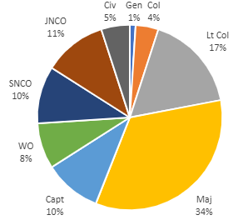
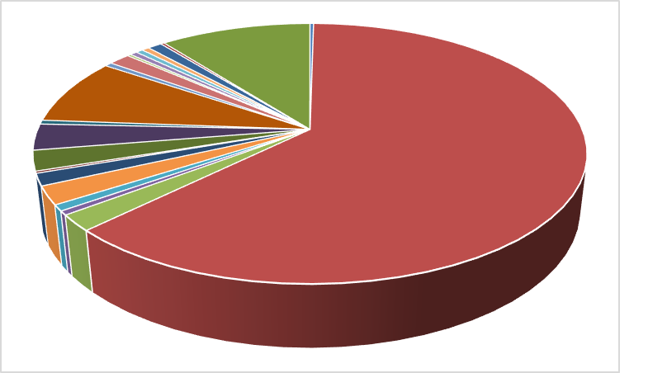







Multinational by Design - Staff
Total PE 429 / filled 404 (94%)
FRA 10
CAN 8
NLD 6
TUR 6
ESP 4
CZE 2
GRC 2
LTU 2
POL 2
PRT 2
DNK 9
33%
ROU 2
DEU 14
ALB 1
ITA 33
20 Nations represented
HRV 1
USA 34
EST 1
GBR 288
LVA 1
Notes:
Slide 4: Manning
2 Minute
GBR mandated to provide 60% of posts as Framework Nation. Currently this sits at 65% of posts.
443 total manned at 91% meet NATO targets
20 nations
UK FN 65%
Rank structure is young: OF3 and OF2 equal half the HQ
NCOS are a ¼ of HQ
A little top heavy with 16% being Colonels and above.
Diverse, multi national, multi cultural – vibrant and fun
True joint, alliance planning
Employability
Networking
Contingents could be small, medium or large however Nations are all great and proud.
For PN personnel it’s a great opportunity to serve in the UK. For FN personnel it’s the gateway to NATO.

Slide 12
ARRC Role
HQ ARRC is to be prepared to deploy:
As a Warfighting Corps HQ
As a Multi Corps Land Component Command
As a NRF Land Component Command
As a Joint Task Force HQ
HQ ARRC will fulfil these roles on a rotational basis in accordance with the Long Term Commitment Plan (LTCP).
Notes:
12
This is the ARRC Mission given by SACEUR, it is driven by the Long Term Commitments Plan which dictates the role of the ARRC.

Slide 13
ARRC Training programme 2021 - 2026
2021
2022
Warfighting Corps HQ
(not at Readiness)
Warfighting Corps HQ
DEFENDER EUROPE 21
DYNAMIC FRONT 22
CERBERUS 22
STEADFAST LEDA 21
STA Corps HQ
DEFENDER 22 M3 CPX
SIDECON to US V Corps
2026
2023
Awaiting LTCP
Direction
Transition / Stand Up year
ARRCADE FUSION 23
?
STEADFAST JUPITER 23
NRF-LCC
PTA (CERT)
2025
2024
Transition / Stand Up year
ARRCADE FUSION 25
NRF-LCC
TBD based on updated LTCP
S/PTA (CERT)
STEADFAST DEFENDER 24 (TBC)
NRF-LCC
POLISH DRAGON (TBC)
Notes:
The Long Term Commitments Plan dictates the roles of the nine GRF(L) HQs in the NATO Force Structure. Each of the GRF(L)s will rotate on a yearly basis, fulfilling each of the roles in turn. There are four roles which the GRF(L)s will fulfil:
Warfighting Corps HQ
NRF Land Component Command
Joint Task Force Headquarters
Multi-Corps Land Component Command – this role will be undertaken for the foreseeable future by HQ LANDCOM
In 2022, the ARRC was originally scheduled to undertake the role of MC-LCC, this has subsequently been taken over by LANDCOM. The ARRC will now continue to focus on Corps WF, but will not officially be @Readiness.

Slide 14



XXX
¿WHAT´S AN ARMY CORPS?
ARRC
HQ
DIV
DIV
DIV
CORPS TROOPS
COMBAT SUPPORT (FIELD ARTILLERY, AIR DEFENCE, ENGINEERS…) & COMBAT SERVICE SUPPORT (LOGISTICS)
X X
X X
X X
BRI
BRI
BRI
BRI
BRI
BRI
BRI
BRI
BRI
X
X
X
X
X
X
X
X
X
BRIGADE: 3/5.000 TROOPS
DIVISION: 20/25.000 TROOPS
ARMY CORPS: UP TO 125.000 TROOPS

Slide 15
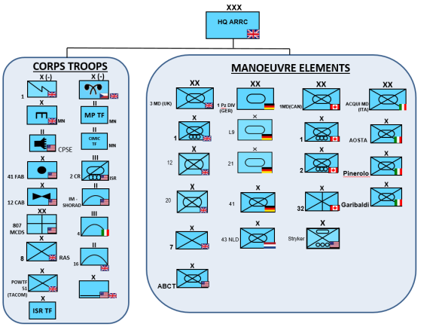
EXAMPLE: STEADFAST LEDA 21

Slide 16
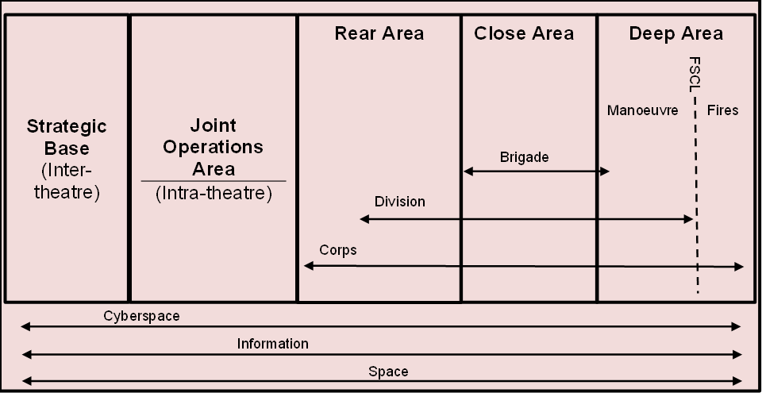
BATTLESPACE: REAR, CLOSE, DEEP AREAS

Slide 17
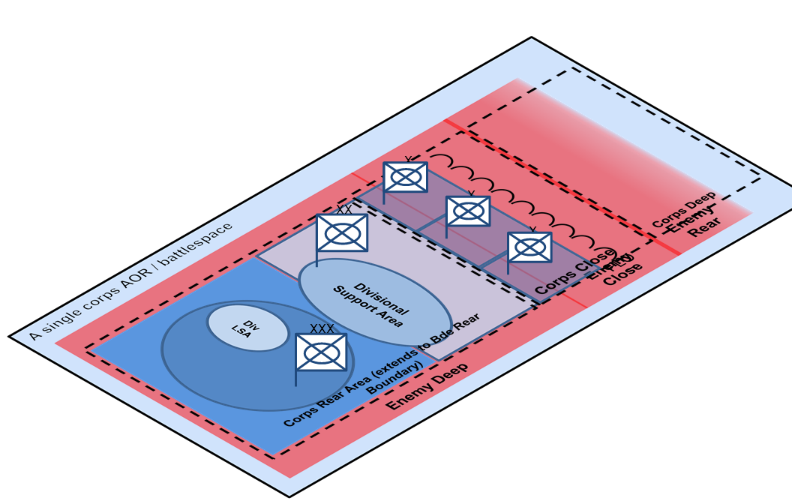
EXAMPLE: SINGLE CORPS BATTLESPACE

Slide 18
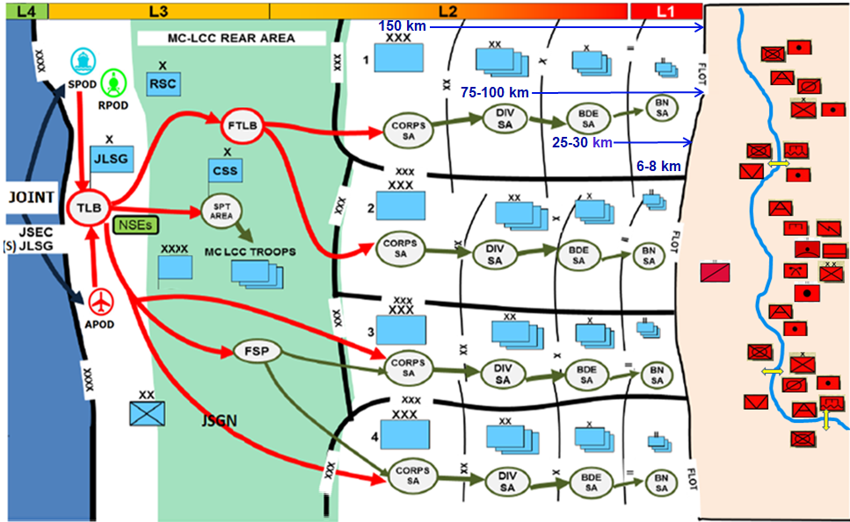
EXAMPLE: MULTI CORPS BATTLESPACE
800- 1000 km
600-700 km

Slide 19
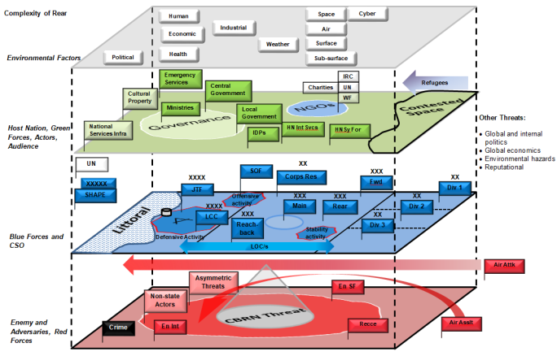
REAR, COMPLEXITY OF THE ENVIRONMENT

Slide 20
REAR AREA OPERATIONS
‘Rear Ops are the largely administrative and logistic activities that occur out of contact with enemy forces, that is, behind the area in which close operations are occurring. Rear Ops require security, particularly in campaigns involving an asymmetric, unconventional adversary*. In all situations there is a need to secure lines of communication. Considerations for rear area security will focus on these lines of communications and other areas that are not manned by combat forces.’
[NATO Allied Tactics Publication 3.2.1: Allied Land Tactics]
*Non-military threats: Irregular threats to Rear Ops are detailed in NATO doctrine as terrorism, espionage, subversion, sabotage and organised crime (TESSOC).

Slide 21
REAR OPS FUNCTIONS
NATO SECRET – REL SWE/FIN
Security.
Area Management.
Logistics.
Movement.
Communications.
Intelligence/Counterintelligence (I/CI).
Civil-Military Cooperation (CIMIC).
Military Engineering (MILENG).
The eight functions
of Rear Ops

Slide 23

Title: What are the key considerations when providing Rear Area Security within a friendly nation?
Overview: The principal challenges for Rear Ops emanate from the complexity of the environment (Picture 1). Not only HN and own forces are operating there, but also other actors, such as contractors or NGO,s. Also the enemy operates in our rear, with military threats, such as air assets, deep fires, cyber, ISTAR or SF, and non-military threats, detailed as TESSOC (Terrorism, espionage, subversion, sabotage and organised crime) The effect it is seeking to achieve is security in the Rear Area, to ensure C5 (Command, Control, Coordination, Cooperation and Collaboration) activities are carried out, as well as secure sustainment activities and LLoC. To conduct these activities in a friendly nation is an added value. The threat level is lower, and HN authorities and Security Forces will support the operations, Coordination is essential: HNS cell plays a key role. Supporting comments. Host Nation Security Forces (HNSF) will support. However, RAS forces must be allocated.
Key Takeaway: Coordination with HN is essential. HNSF can support us, but we shouldn’t take for granted they will do the job. We must allocate forces to protect the rear.

Slide 24
TAKEAWAYS
Coordination is essential, many actors involved (Complexity of Rear Area). Rear CP must track everything going on in Rear Area.
Security in the Rear Area is a combination of
Units self-defence capabilities.
Rear area security (RAS) force.
HN security forces: HNS Cell liaison.
The Rear CP focuses on intelligence led ops. A team from G2 Cell is based in the Rear CP and provides linkages to the Corps intelligence products and assessments.
The Hybrid Fusion Cell’s efforts to integrate information ops, military policing, HNS and CIMIC ops occurring in the rear battlespace to achieve desired kinetic and non-kinetic end states.

Slide 25
Notes:
25

